Slide 1
UNIT 4
This unit deals with contemporary issues of our time affecting humans and the environment
Including water quality and health, Some toxicology principles Integrated Water Resources Management, COVID 19 Pandemic,
DALY (Disability adjusted life years) and Environmental Quality Index
Ghana’s Environmental Protection Bureau
Environmental Impact assessment

Slide 2
Water Quality and Health
Water is very important for every human being as well as other organisms. Water thus has become a major source of pathogenic organisms and because we are in the tropics we suffer greatly from such diseases. Most of them are from human faeces and due to poor sanitation practices we also suffer greatly. Water also is a universal solvent and dissolves several chemical substances. All these have had grave consequences on human health. The world is currently running out of clean water as water bodies become polluted due to anthropogenic activities. This calls for clarion call to ensure proper management of water resources known as integrated water resources management . This section will look at some of the pollutants and the type of disease they cause together with how the chemicals in the water are assessed toxicologically and integrated water resources management.

Slide 3
Water Quality
Aim
To provide you with information on what parameters are considered when defining the quality of water
To offer you a survey of situations and conditions in which the quality of water changes

Slide 4
A six minute video on micro-organims
https://youtu.be/fU0XO1X1tAE
Microorganims are living things that we cannot see with our naked eye.
These are viruses, bacteria, protozoa, algae and fungus
Helminths have been added because the mode of infection which are their eggs cannot be seen with the naked eye

Slide 5
Bacteria
Bacteria are unicellular organism found almost everywhere including hot springs. Some are beneficial but others are also harmful. Bacteria are the cause of many diseases associated with poor sanitary practices. Their generation time is very short e.g. as short as 12 minutes.
Nitrification pays a major role in the nitrogen cycle and is carried our by Nitrosomonas or nitrifying bacteria as presented in the equation below:
C₅H₇O₂N + 5 O₂ → H₂O + 4 CO₂ + NH₄⁺ + HCO₃⁻
Others are used in the food and beverage industry like bread and beer.

Slide 6
Pandemic Covid 19
This is a virus which causes severe acute respiratory syndrome SARS.
Taxonomically is a strain of SARSr related coronavirus(SARSr-CoV). Believed to have zoonotic origins and has close genetic similarity to bat corona viruses.
Genus name is Betacoronavirus
Species is Severe acute respiratory syndrome-related coronavirus
A positive-sense single stranded RNA virus
Discovered in 2019 in the city of Wuhan China
Highly infectious in humans and is airborne

Slide 7
Routes of Transmission and control of COVID 19
Through the mucosal membrane of the ocular, buccal and nasal cavities
Unfortunately, the virus has been found in human faeces making it a serious faecal oral transmission route.
Strict adherence to hygiene must be practiced and wearing of nose and facial masks are recommended
Regular handwashing with soap under running water is highly recommended.
Hand sanitizers which are alcohol based is also very essential
Scientists are developing vaccines and medications to control and eliminate the disease from the world

Slide 8
Water associated diseases
There are four categories of diseases transmitted by microbes which associated with water. These are mainly due to poor hygienic practices and thus are sanitary related.
1. Water borne
2. Water washed
3. Water based helminth diseases
4. Water vector borne related diseases

Slide 9
Public significance of diseases associated with excreta and water related diseases
Classification of water and related diseases
Disease Cholera Infectious hepatitis Polio Paratyphoid Typhoid | Waterborne | Disease Guinea worm Schistosoma (Bilharzia) | Water-based
Amoebic dysentery Bacillary dysentery Gastroenteritis | Waterborne or water –washed | Malaria Onchocerciasis Yellow fever Sleeping sickness | Water related insect vector
Ascaris Conjuctivitis Diarrhoea diseases Leprosy Scabies | Water –washed

Slide 10
Water quality and health
Waterborne disease- Diseases spread by contamination of water (or hands) by human feaces or urine. With this type of disease, infection occurs in a manner as shown in the scheme below:
Infected person → Pathogens in excreta→ contaminated water source
Susceptible person consumption of untreated water
Preventive measures: Improve quality of drinking water. Prevent casual use of untreated or unimproved sources
Water based helminth disease- Diseases whose causative pathogen spend part of its life cycle in aquatic animals such as water snails. The most well known example is schistosomiasis. Its pattern of disease transmission includes a part of the pathogen (worm) life cycle in an intermediate host (as eggs in snails). After the eggs of the worm have penetrated a snail they hatch inside the snail. These larvae can only survive for 48 hours in water.
The larvae can however, penetrate the skin of human beings and they can then migrate through the body, where they can multiply. It is unfortunate that schistosomiasis is often spread by irrigation schemes which tend to provide suitable habitats for the snail host as wells as increasing the likelihood of contact with the water by agricultural workers.
The scheme of development of the pathogen is given as follows:

Slide 11
Water quality and health
Preventive measures: Desist from the use of or contact with any water resource known to have the infection. Control snail population and prevent people or inhabitants from defecating in surface waters.
Water – related insect vector diseases
Diseases spread by insects that breed or feed near open surface waters eg. malaria.
Preventive measures: include avoiding suitable habitats for insect like shallow stagnant water pools, regions around the edges of lakes and irrigation canals. Control by the use of insecticides, although this measure has the possibility of creating some water quality problems. Biological control measure like the introduction of fish species that prey on the larvae of the insect could be adopted.

Slide 12
Integrated Water resources Management
This part briefly looks at the water available for human and other uses,
The hydrological cycle and management of the water available.
Sources of water
Rain
Surface water in the form of streams, rivers and lakes
Groundwater
Water at the poles
Water in the clouds
Sea water
Soil

Slide 13
The Water Cycle
Water travels on the surface of the earth, underground and in the atmosphere in a cycle – the Water Cycle.
Clouds provide precipitation in the form of rain, snow and hail.
Water runs on the surface. Part is used by the vegetation; part flows to the water bodies or infiltrates the soil to form the underground water bodies.
Surface water bodies evaporates under the effect of the sun and finds itself in a gaseous form in the atmosphere.
Water vapour condenses in contact with cold air masses, which then creates clouds and comes down as rain.
Invisible phenomena
Evaporation, absorption, water vapour and transport by winds – sun energy required for process
Visible phenomena – condensation, precipitation, snow, runoff, infiltration, superficial and underground flow.

Slide 14
Water Quality
As precipitated water encounters the atmosphere and the environment, its quality changes through interactions with:
- Gases in the air
- soil and rock– contaminants
- anthropogenic activities eg mining, agriculture and irrigation, industries e.g. dyeing and tannin

Slide 15
Water use
About 66% of the human body is made up of water
Depending on the human body needs about 3 – 10 litres of water / day is required for normal functioning.
Uses – cooking, recreation, laundry, drinking gardening, transportation, waste disposal, fire fighting, industrial applications etc.
Influences: Cultural habits, pattern and standard of living, utility fee for water, quality of water, proximity of water source.
In the selection of the type of water supply / source, finance, location, size of community, geographical conditions and the available water source are normally the major considerations.

Slide 16
Water consumption
Water use and consumption are normally expressed in litres per capita(head) per day (l.c.d).
l.c.d is useful for making rough estimates of a community’s water demand

Slide 17
Typical Domestic Water Usage
Type of water supply Typical water Range (l.c.d)
consumption (l.c.d)
Communal water point
(e.g. village well, public stand-post)
- at considerable dist. (>1000 m) 7 5 - 10
- at medium dist.(500 – 1000m) 12 10 - 15
Village well
walking distance < 250m 20 15 - 25
Communal standpipe
walking distance < 250m 30 20 - 50
Yard connection
(tap placed in house-yard) 40 20 - 80
House connection
- single tap 50 30 - 60
- multiple taps 150 70 - 250

Slide 18
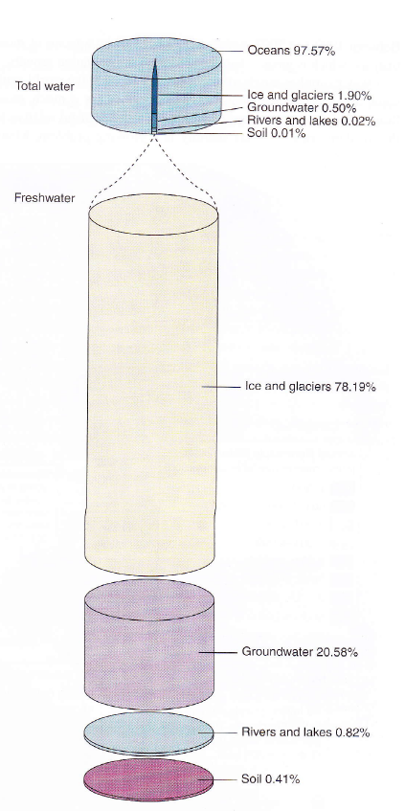

Slide 19
Water and Wastewater Quality parameters
Important properties of water focused on when considering water quality include, the bpt., Melting pt., vapour pressure, surface tension, solvent, density, heat capacity.
The very notion of water quality is linked to the intended use of the water: swimming, drinking and cooking, irrigation, industrial process water etc. Whatever we use it for, its quality must be preserved. As the natural content varies considerably. We must define average conditions for natural and safe waters. Above a predestined threshold, water will be declared polluted.

Slide 20
Water pollution
Water pollution is a harmful modification of water caused by the addition of substances likely to modify its quality, aesthetic aspect and use for human purposes. The polluting agent may be physical, chemical or biological in nature and cause discomfort, nuisance or contamination

Slide 21
Wastewater effluent guidelines
Parameter | EPA Ghana Guidelines
BOD5 mg/l | 50
COD mg/l | 250
pH | 6-9
Total Phosphorous mg/l | 50
Total Nitrogen mg/l
Total suspended solids mg/l | 50
Total Dissolved solids mg/l | 1,500
E.coli MPN/100ml | 10
Total coliforms MPN/100ml | 400
Mercury mg/l | 0.005
Lead mg/l | 0.1
Arsenic mg/l
Chromium (+6) mg/l | 0.005
Sulphide mg/l | 0.3
Nitrates mg/l | 0.1
Cadmium mg/l | <0.1
Total Phosphorous mg/l | 2
Dissolved Oxygen | 1
Turbidity (NTU) | 75

Slide 22
IRON AND MANGANESE
Consumer complaints – dark brown to black precipitates, stain laundry and porcelain fixtures Coating and darkening of filters in treatment plant Concentration as low as 0.02 mg/l could form coating in distribution mains, service lines, meters chronic exposure to manganese concentration beyond 0.5mg/l could give rise to a disease condition similar to Parkinsonism.
WHO health based guideline for manganese occurrence in drinking water is pegged at 0.4 mg/l (WHO guideline 2004). WHO guideline value of 0.1 mg/l has been recommended for Mn for drinking water sources

Slide 23
ARSENIC
Long term exposure to drinking water with [As] > 10 μg/l
Can cause cancer of the skin, lungs, urinary bladder, kidney, etc
Skin pigmentation,
Hardening and laceration of sole of feet.
Retardation in the intelligence of children.
In Ghana – upsurge in the incidence of cancer especially breast, meanwhile patronage of groundwater as drinking water source is on the increase.

Slide 24
FLUORIDE (high fluoride a very serious problem in Northern Ghana
The claim of F⁻ being beneficial has not held up
independent scientific scrutiny.
High [F⁻] → more brittle and fragile bones, increased bone mass density but reduce strength of the bone at the same time due to F- caused defects in the bone structure.
F- + Al in drinking water → accumulates in brain → neurotoxic morphological changes.
A study in China has shown that even accepted levels in F- in water (0.88 mg/l) may affect children’s intelligence
High F- is also a contributing factor to a bone cancer condition of osteosarcoma.
May cause elevation in blood sugar possibly exacerbating diabetes.

Slide 25
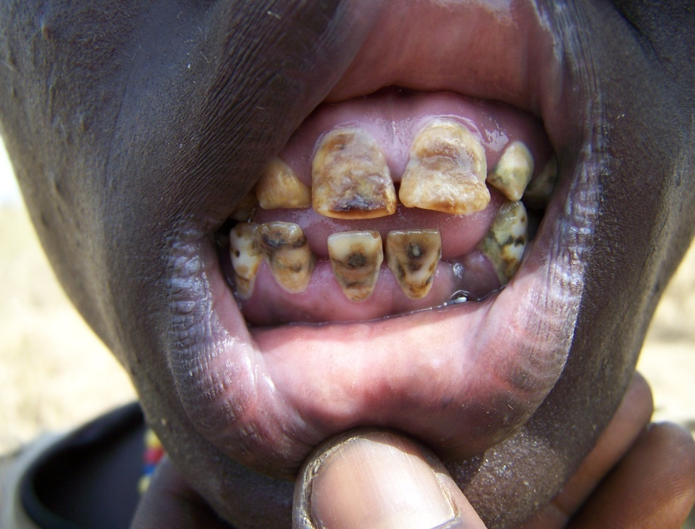
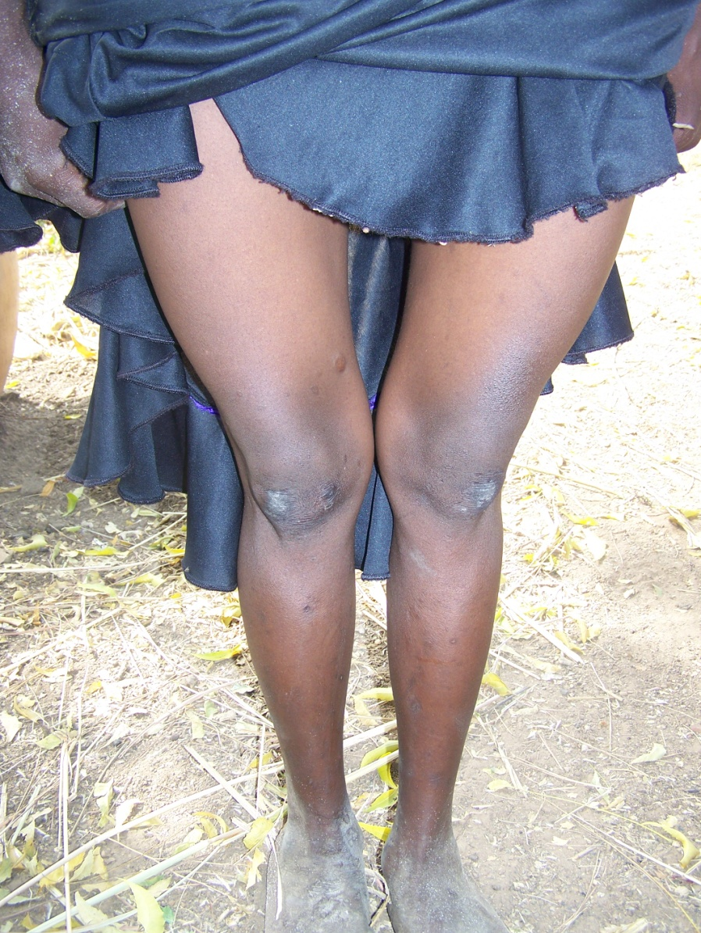
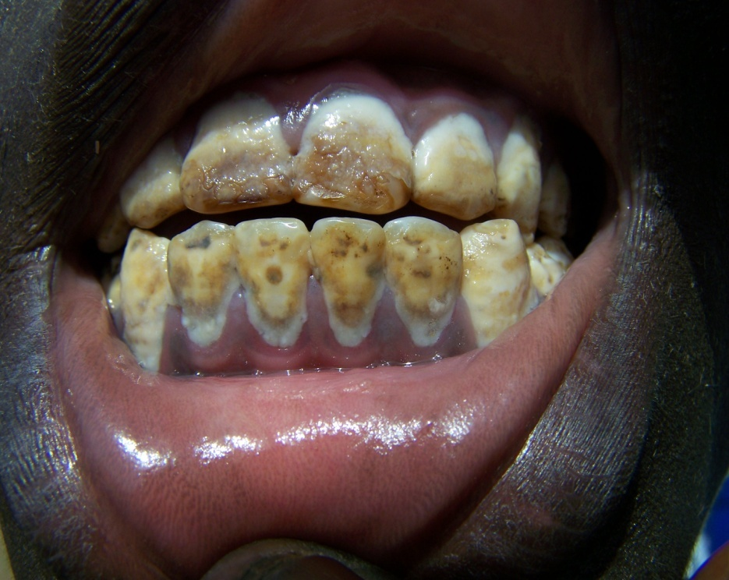
Effects of excess flouride

Slide 26
Heavy metal health impacts
LEAD -Anaemia, mental retardation,
MERCURY
Mercury is a naturally occurring element that is found in air, water and soil.
Exposure to mercury – even small amounts – may cause serious health problems, and is a threat to the development of the child in utero and early in life.
Mercury may have toxic effects on the nervous, digestive and immune systems, and on lungs, kidneys, skin and eyes.
Mercury is considered by WHO as one of the top ten chemicals or groups of chemicals of major public health concern.
People are mainly exposed to methylmercury, an organic compound, when they eat fish and shellfish that contain the compound.
Methylmercury is very different to ethylmercury. Ethylmercury is used as a preservative in some vaccines and does not pose a health risk.
Our water bodies are now been seriously contaminated with mercury due to illegal mining activities

Slide 27
Other health impacts dues to chemicals
SO₂ released from industries causes Bronchitis
Acid rain – precipitation causes corrosion of monuments and materials.
Changes acidity of water bodies and can cause death of fish
Impedes photosynthesis.
The presence of all these chemicals in the water we consume calls for special toxicity tests to limit the amount of contaminants that are safe for human consumption

Slide 28
Toxic Chemical compounds and their extent of toxicity
In toxicology the adverse effects of chemicals (pollutants) on living organisms is studied and the probability of these effects occurring upon consumption of the pollutant is considered.
The toxicity of a pollutant is described using various terminologies:
Lethal dosage, ADI, MAC etc.
The toxicity of a chemical substance in water depends upon several factors other than the actual concentration. Some substances, which are highly toxic, are unstable in water and break down into innocuous by-products. The degree of toxicity also has to be assessed on the daily intake from sources other than water, for example lead pollution in air.

Slide 29
Toxic Chemical compounds and their extent of toxicity
Sub-acute toxicity
This is often expressed using the no observed effect level
or no observed adverse effect level (NOAEL)
The NOAEL is the highest dose or concentration of a
substance that causes no detectable health effect. (Based
on long term studies)
In some cases LOAEL may be used. LOAEL refers to the
lowest observed dose or concentration of a substance at
which there is a detectable adverse health effect.

Slide 30
INDUSTRIAL WATER Maximum conc. Of constituents in raw waters for various industrial operations (mg/l)
Characteristic | Boiler water | Cooling water | Textile Plants | Pulp and paper | Chemical industry | Petroleum
Silica | 150 | 50 | - | 50 | - | 85
Aluminum | 3 | 3 | - | - | - | -
Iron | 80 | 14 | 0.3 | 2.6 | 10 | 15
Manganese | 10 | 2.5 | 1.0 | - | 2 | -
Calcium | - | 500 | - | - | 250 | 220
Magnesium | - | - | - | - | 100 | 85
Ammonia | - | - | - | - | - | 40
Bicarbonate | 600 | 600 | - | - | 600 | 480
Sulfate | 1400 | 680 | - | - | 850 | 900
Chloride | 19000 | 600 | - | 200 | 500 | 1600
Nitrate | - | - | - | - | - | 8
Dissolved solids | 35000 | 1000 | 150 | 1080 | 2500 | 3500
Suspended solids | 15000 | 5000 | 1000 | - | 10000 | 5000
Hardness | 5000 | 850 | 120 | 475 | 1000 | 900
Alkalinity | 500 | 500 | - | - | 500 | 500
Color | 1200 | - | - | 360 | 500 | 25

Slide 31
Integrated Water Resource Management
Integrated management means that all the different
users of Water resources are considered together.
Water allocations and management decisions consider
the effects of each use on the others. They are able to
take account of overall social and economic goals,
including the achievement of sustainable development.

Slide 32
The Facts
Global water: 97% seawater, 3% freshwater. Of the freshwater 87% not accessible, 13% accessible (0.4% of total).
Today more than 2 billion people are affected by water shortages in over 40 countries.
263 river basins are shared by two or more nations;
2 million tonnes per day of human waste are deposited in water courses
Half the population of the developing world are exposed to polluted sources of water that increase disease incidence.
90% of natural disasters in the 1990s were water related.
The increase in numbers of people from 6 billion to 9 billion will be the main driver of water resources management for the next 50 years.

Slide 33
Within this IWRM principle, it is vital to recognise first the basic right of all human beings to have access to clean water and sanitation at an affordable price.
Water has a value as an economic good as well as a social good.
Many past failures in water resources management are attributable to the fact that the full value of water has not been recognised and has led to wasteful and environmentally damaging uses of the resource.
Allocation
Treating water as an economic good is an important means for decision making on the allocation of water. This is particularly important when extending supply is no longer a feasible option.

Slide 34
Agriculture
Water supply & wastewater
Mining, industry
Environment
Fisheries
Tourism
Energy
Transport
Each of the water uses identified above has valuable positive impacts.
Most also have negative impacts which may be made
worse by poor management practices, lack of regulation
or lack of motivation due to the water governance
regimes in place. Water management within government
structures is distributed across many agencies and tends
to be dominated by sectoral interests.

Slide 35
Agriculture Water
Water Quality for irrigation (tropical conditions)
TDS
- < 400 mg/l – poor drainage
saline soil
inadequate water supply
< 1000 mg/l – good drainage
- proper irrigation management
< 2000 mg/l – salt resistant crops
- good drainage
- low sodium adsorption ratio (S.A.R.)
E.C. < 100 mS/m (25˚C)
SAR < 10 - poor drainage
< 18 - good drainage

Slide 36
Quality requirements for fishing in tropical streams
CO₂ <12 mg/l
pH 6.5 – 8.5
NH₃ <1
Heavy metals <1
Copper <0.02
As <1
Pb <0.1
Selenium <0.1
Hg <0.01
Cyanides <0.012
Detergents <0.2
DO >2
Pesticides
DDT <0.002
Endrin <0.004
Methylparathion <0.21
Malathion <0.16

Slide 37
Fresh water is a finite and vulnerable resource, essential to sustain life, development and the environment.
Water development and management should be based on a participatory approach, involving users, planners and policymakers at all levels.
Women play a central part in the provision, management and safeguarding of water.
Water has an economic value in all its competing uses and should be recognised as an economic good.
The participatory approach involves raising awareness of the importance
of water among policy-makers and the general public. It means that
decisions are taken at the lowest appropriate level, with full public
consultation and involvement of users in the planning and implementation
of water projects

Slide 38
SOME ACTIVITIES TO EMBARK UPON FOR INTEGRATED ENVIRONMENTAL RESOURCES MANAGEMENT
Awareness creation
Proper Solid and Liquid Waste management
Creation of buffer zones for water bodies
Development of woodlots
Appropriate farming (both crops, fishing and animal farming) practices
Water Abstraction, Use and Drilling license
Creation of Game reserves

Slide 39
Ghana’s Environmental Protection Bureau, EIA and Some Principles of Environmental laws
With the massive pollution problems mankind is facing each country in addition to the provision of the concerted efforts globally, is supposed to address its own local environmental challenges. It is in line with these directives that Ghana has established its own Environmental Protection Bureau (EPA) which supervises the implementation of policies and regulations to protect the local Environment. One of such key regulation is the requirement for all developmental projects to undertake an Environmental Impact Assessment before Project implementation.

Slide 40
Ghana’s Environmental Protection Agency
In order to implement all these environmental regulations and Agency has to be established to develop the laws and regulations to manage that aspect
The Environmental Protection Agency, is an agency of Ministry of Environment, Science Technology and Innovation, established by EPA Act 490 in 1994. Prior to that it was just a advisory council called Environmental Protection Council established in 1974 after a world conference on Environment in Stockholm 1972.

Slide 41
Functions of EPA
The agency is dedicated to improving, conserving and promoting the country’s environment and striving for environmentally sustainable development with sound, efficient resource management, taking into account social and equity issues. It oversees the implementation of the National Environment Policy.^{[2]} EPA Ghana's mission is to manage, protect and enhance the country’s environment and seek common solutions to global environmental problems. Its mission is to be achieved through an integrated environmental planning and management system with broad public participation, efficient implementation of appropriate programmes and technical services, advice on environmental problems and effective, consistent enforcement of environmental law and regulations. EPA Ghana is a regulatory body and a catalyst for change to sound environmental stewardship.

Slide 42
Environmental Assessment
There are several procedures for assessing environmental quality
These are Environmental Impact Assessment (EIA)
Strategic Environmental Assessment (SEA)
Environmental Risk Assessment
Environmental audit etc
We shall focus on EIA which now has social impact assessment as a key Component

Slide 43
Environmental Impact Assessment
EIA is a process of assessing environmental impact of a development project to improve decision making on its implementation
Brief History (Before the concept of EIA)
Project evaluation – formerly prior after the execution of a major project there used to be project evaluation. This was based on technical studies valued in monetary terms (cost benefit analysis).
Rough evaluation – full of shortcomings and failures
Efforts to develop new evaluation approach led to EIA. In this Technical, Financial, Economic and Environmental aspects were given their proper weight in the decision making process.

Slide 44
ENVIRONMENTAL IMPACT ASSESSMENT
1960 in the USA to create environmental awareness
1962 - First evidence of local application of insecticides had far reaching ecological impacts
Environmental aspects of projects became a requirement for decision making
National Environmental Policy Act / Law (NEPA) published in 1970. Environmental impact Statements ( EIS ) should be published for major actions significantly affecting quality of human environment.

Slide 45
Purpose of the EIA
It enables financier/ client to take environmental issues into account
It seeks to compare the various alternatives which are available for any project. Each alternative will have economic cost and benefit as well as environmental impact. Adverse impacts may be reduced at higher project cost whilst environmental benefits may be enhanced at environmental cost.
It attempts to weigh the environmental effects on a common basis with economic cost and benefit in the overall project evaluation
It identifies and forecasts the possible positive and negative impacts to the environment resulting from a proposed project.
It helps to avoid costs and delays in implementation.

Slide 46
Some common targets
EIA seeks to identify probable alternatives for project with little or no adverse impacts on the community or environment.
EIS (Environmental Impact Statement) is the assessment report produced after the assessment exercise; it details both the beneficial and adverse impacts anticipated upon completion of a project and the probable impacts that would be experienced during the operational phase of the project.
To perform an EIA about 5 major parties are involved:
The Proponent or the Initiator e.g. Gov’t agency, private personnel, company etc.
Decision makers – Central or Local gov’t agency, provincial official (EPA – Gh)
Review Commission – EPA, EIA committee – management committee

Slide 47
It provides a formal mechanism for direct agency co-ordination to deal with concerns.
It measures the level of plan implementation and the degree of effectiveness of the above environmental protection provision.

Slide 48
Some key environmental laws, policies and regulations in Ghana
Ghana is still in the process of developing laws to protect the environment in addition to several environment laws dating back as 1892 on the Towns Ordinance which ensures proper planning of towns
LI 1999 for the mandatory requirement for Environmental Impact Assessment for Development projects
Public Nuisance Decree Act 29 of 1960 Prevent indiscriminate disposal of waste and noise disturbance.
Ghana Investment code of 1988 which mandated all investors to examine the impact of their activities on the environment
There are guidelines for the various levels of sound for different places
Guidelines for effluent discharges from industries
Guidelines for ambient air quality
Environmental sanitation policy of 2010. This needs to be revised.
Water policy of 2007 also needs to be revised

Slide 49
Principles of Environmental laws
Several principles guides the development of these laws.
1. Precautionary: This is done when the impact is not known bust suspected
Prevention: Impacts are known and the laws are made to prevent them. Most environmental laws are based on this principle
Polluter pays: Ensures that industries pay for impact of the harmful effects of their products through life cycle of the product
Integration: Integrates environmental concerns in all decisions of corporate bodies and activities
Public participation: Incorporates the views of the public as well.
Sustainable development: This is an approach to economic planning to foster development whiles preserving the environmental quality for present and future generations. This has been difficult to do because of the multipurpose nature of resources in question. Key sustainable laws are in ecotourism

Slide 50
Levels of Environmental laws
It exists at three main levels
1. international declarations, conventions and treaties
National laws are generated by agencies charged by Governments with the protection of the environment
Local laws such as the sanitation by laws are developed by Assemblies
Incentives are also provided by some of these national laws to encourage the compliance of the laws. Such as pollution taxes for the use of clean technologies

Slide 51
Types of Environmental laws
Command and control
Identification of harmful effects
Imposition of specific conditions of standards for the control
Imposed conditions for failing to apply
Environmental Assessments mandates
Identification of a level of threshold potential impact which will require an EIA report
Establishment of specific goals for the assessment
Setting of requirements to decide whether to proceed with the action or not

Slide 52
The EIA process
Includes
Project description and the legal and administrative framework
Scoping and screening which will look at the major impacts
The description of the environment for the project
Analysis of alternatives
Impacts associated with the project with a check list of all things the project can have impact
Mitigative measures in place

Slide 53
Environmental Assessment procedures
A preliminary form is collected from the Ghana Environmental Protection Agency to determine the nature of the project whether an EIA is required.
If it is needed the proponent seeks consultants to help in the development of the report which is assessed and approved by the EPA after public hearing.

Slide 54
DALY Disability adjusted life years
DALY is a health gap measure that extends the concept of potential years of health life lost due to premature death (PYLL) to include equivalent years of healthy life lost as a result of a disability.
The DALY combines one measure of the time lived with a disability and the time lost due to premature mortality
In the application of DALY to environmental studies, we only look at DALY as time lost in years to a disability as a result of an environmental hazard or disease due to environmental neglect like incidence of malaria, time lost due to air pollution etc in a community in years.
Eg How many years are lost as result of people been hospitalized due to air pollution problems in a community. Suppose the community has a population of 1000 and 200 people were hospitalized for three 5 days due to air pollution in one month.
Example of The DALY in this case is 200X 5 =1000 days /365 days which is equal to 2.7 years lost in that community in just one month

Slide 55
Environmental Quality Determination
Depends on:
population,
resource used and
impact generated from resource used
Q = IFP
Where
Q = level of pollution or the Environmental Quality Index
I = impact index (pollution per unit of resource consumed.
F = amount of materials resource or energy resource consumed per person
P = size of population.

Slide 56
Example of Environmental quality measurement
Determine the Environmental quality Index of a hair dressing salon at Ayeduase in a day if the number of people who come to the salon daily is 120.
Each person uses 30 Litres of water for her hair washing and styling.
The pollution load in the water which is the impact is 40mg of Dissolved Organic matter per litre
Q=IFP
Q is the level of pollution of Environmental Quality index
I is the impact per unit resource used ie organic matter dissolved per litre
P is the size of the population, F is the amount of resource used per person
Thus Q= 40mg/l x 30L x 120=144,000 in grams

Slide 57
Environment impacts associated with various engineering disciplines
The impacts of the old engineering practices are known because they have been in existence for long:
Civil engineering -changing of landscape, land degradation
Agricultural engineering –land degradation, water pollution with pesticides, depletion of ground water resources
Mechanical Materials, chemical, petroleum engineering cause Noise pollution, fossil fuels depletion and air pollution
Computer engineering impact details on man and the environment are not known apart from electromagnetic radiations.
Impact of every the new disciplines will be better understood with time and also if a life cycle analysis is carried on the products developed.

Slide 58
The Millennium Development goals
This was initiated in 2015 to promote human wellbeing.
The goal had 8 goals and the implementation ended in 2015
At the end of the period sub-Saharan Africa could not achieve all the goals

Slide 59
Key facts from JMP 2015
SubSahara Africa
Population
962 million
Access to at least basic drinking water - 58 %
Access to safely managed sanitation - 28%
Ghana
Access to basic drinking water - 78%
Access to safely managed sanitation - 14.3%
Open Defecation - 19

Slide 60
Environmental sustainability
The United Nations Conference on Environment and Development in 1992 in Rio de Janerio, Brazil
Set out a roadmap for sustainable development.
In a follow up conference in South Africa in 2002
Why is there a lack of international progress in reducing poverty and protecting the environment? Discuss this.
Stnble – Sustainable’
Social
Equitable
Bearable
Stnble
Environment
Viable
Economic

Slide 61
The MDGs Interest groups
Governments
NGOs,
General Universities
Chiefs,
District Assmeblies
Consultants
Companies
etc

Slide 62
MILLENIUM DEVELOPMENT GOALS
Eradicate extreme poverty and hunger
Achieve universal primary education for all
Gender equality
Child health
Maternal health
Combat HIV/AIDS
Ensure environmental sustainability
Global partnership

Slide 63
GOAL 7 ENSURE ENVIRONMENTAL SUSTAINABILITY
Target 1
Integrate the principles of sustainable development into
country policies and programmes and reverse the loss of
environmental resources.
Target 2
Reduce biodiversity loss; achieving by 2010, a significant
reduction in the rate of loss
Target 3
Halve, by 2015, the proportion of the population without
sustainable access to safe drinking water and basic
sanitation
Target 4
By 2020 to have achieved a significant improvement in
the lives of at least 100 million slum dwellers

Slide 64
Target 1 Integrate the principles of sustainable development into country policies and programmes and reverse the loss of environmental resources.
Immediate action is needed to contain rising green house gas emission.
Success in limiting ozone depleting substances is also helping to mitigate climate change

Slide 65
Target 2 Reduce biodiversity loss; achieving by 2010, a significant reduction in the rate of loss
Marine areas and land conservation need greater attention
Deforestation slows and more forests are designated for biodiversity conservation
The number of species threatened with extinction is rising rapidly
Fish stocks require improved fisheries management to reduce depletion

Slide 66
Target 3 Halve, by 2015, the proportion of the population without sustainable access to safe drinking water and basic sanitation
Almost half of the world’s population face a scarcity of water
More people are using improved sanitation facilities, but meeting the target will acquire a redoubling of efforts
In developing regions, nearly one in four uses no form of sanitation
Though access to improved drinking water has expanded, nearly one billion people do without
Women shoulder the largest burden in collecting water

Slide 67
Target 4 By 2020 to have achieved a significant improvement in the lives of at least 100 million slum dwellers
Simple, low – cost interventions could significantly improve the lives of many slum dwellers

Slide 68
Sustainable Development Goals
In September 2015, The United Nations adopted the 2030 Agenda SDG with 17 goals to succeed the MDGs
The SDGs are to address the following dimensions of sustainable development:
environment
economic
social
The time Horizon is 2015-2030

Slide 69
The SDG goals
1. No poverty
2. Zero Hunger
3. Good health and well being
4. Quality Education
5. Gender Equality
6. Clean Water and Sanitation
7. Affordable and clean Energy
8. Decent work and economic growth
9. Industry innovation and infrastructure
10 Reduced inequality
11. sustainable Cities ans communities

Slide 70
SDG Cont’nd
12. Responsible consumption and production
13. Climate Action
14. Life below water
15. Life on Land
16. Peace and justice strong institutions
17. Partnership to achieve the goals

Slide 71
Incorporation of SDGs in National Development Agenda
THE National Development Planning Commission is the lead government Institution on Development Planning policy and strategy.
The SDGs must be triggered down in our all our communities including all programs in our Universities to enhance the achievement of the goals

Slide 72
Facts for Water and sanitation
2.6 billion people have gained access to improved drinking water sources since 1990, but 663 million people are still without
At least 1.8 billion people globally use a source of drinking water that is faecally contaminated
Between 1990 and 2015, the proportion of the global population using an improved drinking water source has increased from 76 per cent to 91 per cent
But water scarcity affects more than 40 per cent of the global population and is projected to rise. Over 1.7 billion people are currently living in river basins where water use exceeds recharge
Floods and other water-related disasters account for 70 per cent of all deaths related to natural disasters

Slide 73
Facts continued
2.4 billion people lack access to basic sanitation services, such as toilets or latrines
More than 80 per cent of wastewater resulting from human activities is discharged into rivers or sea without any pollution removal
Each day, nearly 1,000 children die due to preventable water and sanitation-related diarrhoeal diseases
Hydropower is the most important and widely-used renewable source of energy and as of 2011, represented 16 per cent of total electricity production worldwide
Approximately 70 per cent of all water abstracted from rivers, lakes and aquifers is used for irrigation

Slide 74
Goal 6 of the SDG
By 2030, achieve universal and equitable access to safe and affordable drinking water for all. By 2030, achieve access to adequate and equitable sanitation and hygiene for all and end open defecation, paying special attention to the needs of women and girls and those in vulnerable situations.
This goal affects the success of almost all the goals and hence the special attention to that.

Slide 75
8 Targets for SDG 6
By 2030, achieve universal and equitable access to safe and affordable drinking water for all
Achieve access to adequate and equitable sanitation and hygiene for all and end open defecation, paying special attention to the needs of women and girls and those in vulnerable situations
Improve water quality by reducing pollution, eliminating dumping and minimizing release of hazardous chemicals and materials, halving the proportion of untreated wastewater and substantially increasing recycling and safe reuse globally
Substantially increase water-use efficiency across all sectors and ensure sustainable withdrawals and supply of freshwater to address water scarcity and substantially reduce the number of people suffering from water scarcity
Implement integrated water resources management at all levels, including through transboundary cooperation as appropriate
Protect and restore water-related ecosystems, including mountains, forests, wetlands, rivers, aquifers and lakes

Slide 76
SDG 6 Targets
Expand international cooperation and capacity-building support to developing countries in water- and sanitation-related activities and programmes, including water harvesting, desalination, water efficiency, wastewater treatment, recycling and reuse technologies
Support and strengthen the participation of local communities in improving water and sanitation management

Slide 77
Assignments1
a) Determine the DALY for the people of Hopeland in one month if the people infected in a month is 1000 cases. The total quarantine period is 21 days for full recovery. b) If the total cost per person’s treatment is 12,000 cedis for the 21days calculate the economic significance of the disease in a month.
Determine the Environmental Quality Index at Beebianeha if each of the 80 welding shops produce 39 ug of Hg/m3 from their foundry activities. Each shop is confined to a space of 500m3.
What impact will this have on the health of the artisans after a long exposure?

Slide 78
Assignment 2
Biomimicry in the class song calls for three key things. What are they? Give examples in ecosystems and where such practice has been used
Why are people not bothered about matters of the environment?

Slide 79
Reading materials
Visit Wikipedia for topics which are not too clear. Wiki has very good reference materials
Living in the environment by George by Tyler Miller 2005
Introduction to environment and society by J. P. Evans 2012
WHO Guidelines for Drinking water

Slide 80
The Epilogue
The environment is a complex system requiring a proper understanding of how things are connected and how they impact each other. The environment in which we live have natural ecosystems that are self sustaining and self regulating. We can learn from nature on how it recycles matter in the ecosystem, manages its problems on water, air, and soil pollution and general interactions with other organisms in the environment.
This concept of biomimicry which is the study of nature's most successful ideas over the past 3.5 million years, and adapt them for human use will go a long way to make our planet livable and healthy.

Slide 81
Class song
Every year a class song is composed to the class highlighting some important aspects of the environment or comtemporary issues related to the environment. ’
This year’s class song is entitled Biomimicry:
We cannot go back to hunter gather days but we can mimic nature for survival DC
Biomimicry for pollution control
Biomimicry for food production
Biomimicry for cooperation
Oh yes study biomimicry

